Slide 1

Early CFE

Slide 2



Welcome
¡Hola!
Hi!

Slide 3

What is Early CFE (ECFE)?
CFE started as early as possible in the case, ideally before Adversary hearing
Supports CASA programs to be appointed at removal and start their advocacy and engagement with families sooner
Engagement tools completed with parents/family at ex-parte if possible and with child soon after
Searching tools utilized if necessary

Slide 4

What ECFE is NOT
CASA is NOT re-investigating the case
CASA is NOT making recommendations about Removal of Child at the Adversary
CASA only actively working IF SAPCR in place at removal

Slide 5

Why ECFE?
Goals:
Connections of the child identified and engaged by the Adversary hearing
Building a relationship with parents and family will ensure a stronger collaboration
Earlier engagement with all involved
CASA advocacy sooner

Slide 6
ECFE Pilot Outcomes
Earlier and more informative engagement with children and families
Stronger collaboration with stakeholders and family
Increased connections known and active by Adversary
Sooner family placements
Positive working relationship between CASA and parents
Increased participation in family meetings by family members

Slide 7

Role of CASA Volunteer in ECFE
Appointed by court
Advocate for child’s best interest (emotional, medical, social and educational)
Ensure child remains connected to those healthy positive relationships while in CPS care
Help ensure family members/connections are located and contacted to help maintain connections

Slide 8
CPI to CASA: Information Sharing
Placement information
Caregiver resource form
School
Parent/guardian information
Known associations
3 in 30 info
FTM’s and inviting CASA
Notes:
Legally required to be shared with CASA

Slide 9

CASA to CPI: Information Sharing
CASA can coordinate things youth may need:
Blankets, clothing, toys, special items, medication, glasses, schoolbooks, etc.
Information gained from CFE tools regarding connections
Family and connection contact information that is new
Information received from visits that may be needed by CPI

Slide 10
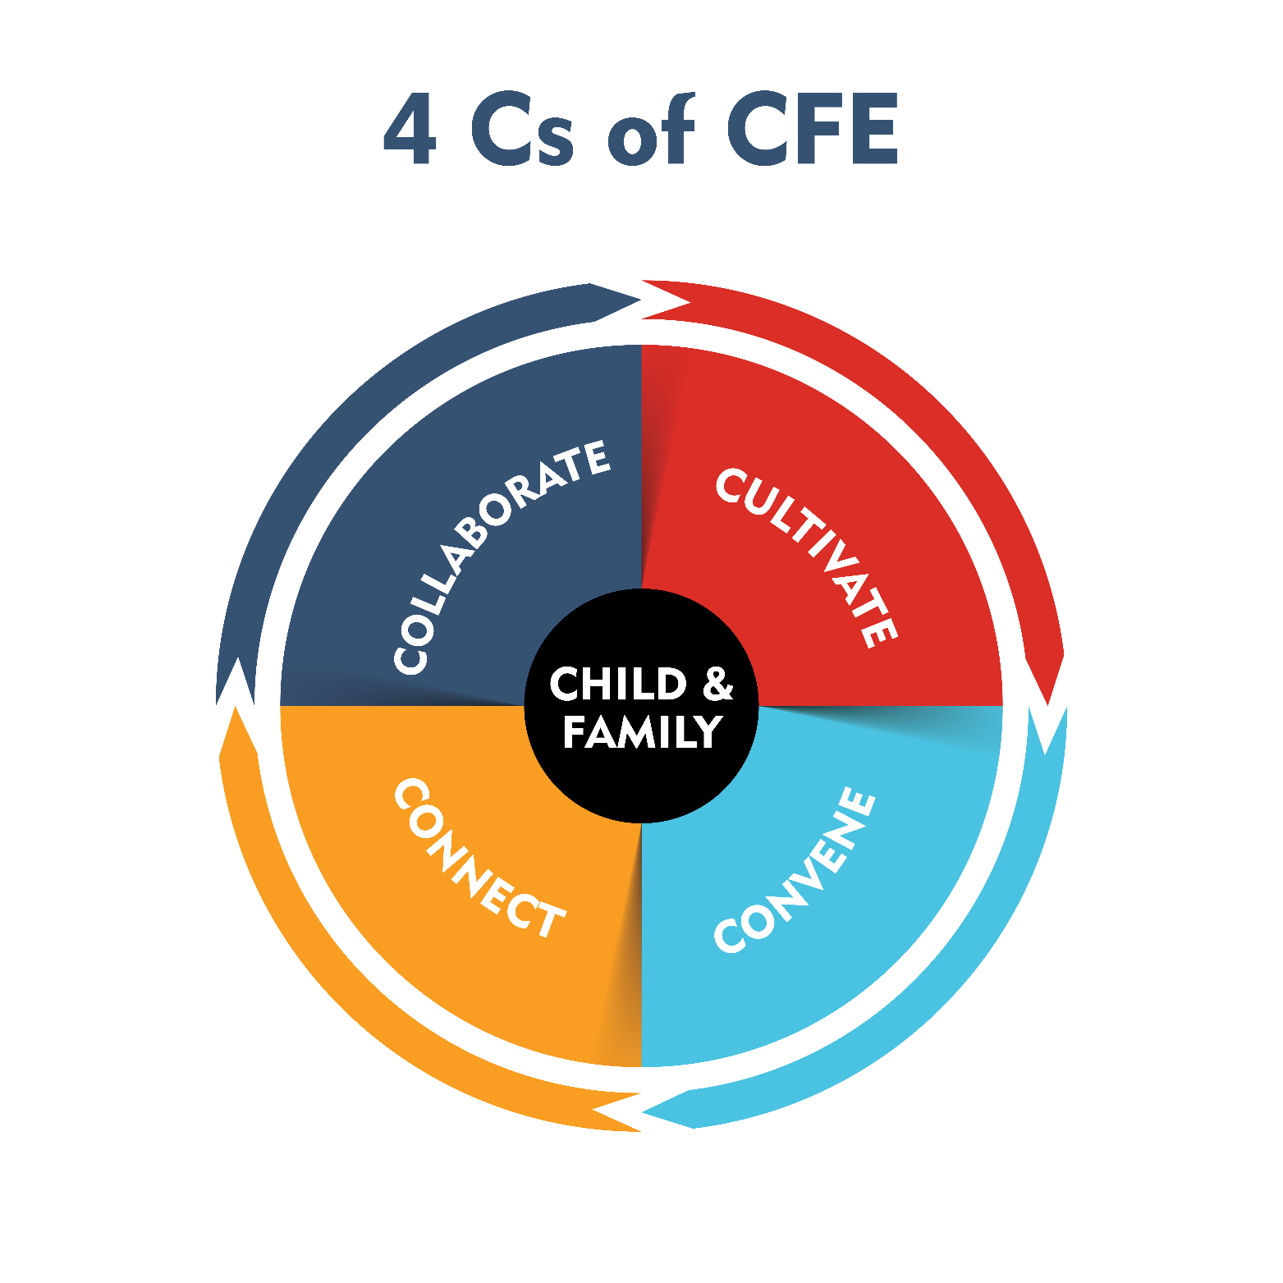
4Cs of CFE

Slide 11
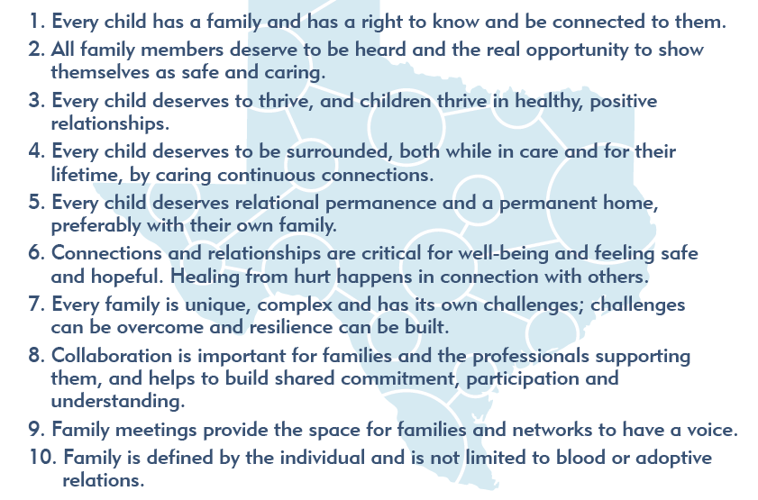
Core Values of CFE

Slide 12

Cultivate- Tools to Engage Family
CASA uses tools to search and engage family
Will share information with CPI and CPS
Legally required to search and engage family by court
Start with engagement
Use of one or more tools
Lots of tools to choose from!

Slide 13
Connectedness Map
Foster Care Community

Slide 14

Impacts of Loneliness & Isolation
Notes:
Focus on the why of CFE – connection and reducing loneliness, dangers of loneliness, unintended consequences. Instead we want to build Courageous Connections! (theme of training)

Slide 15
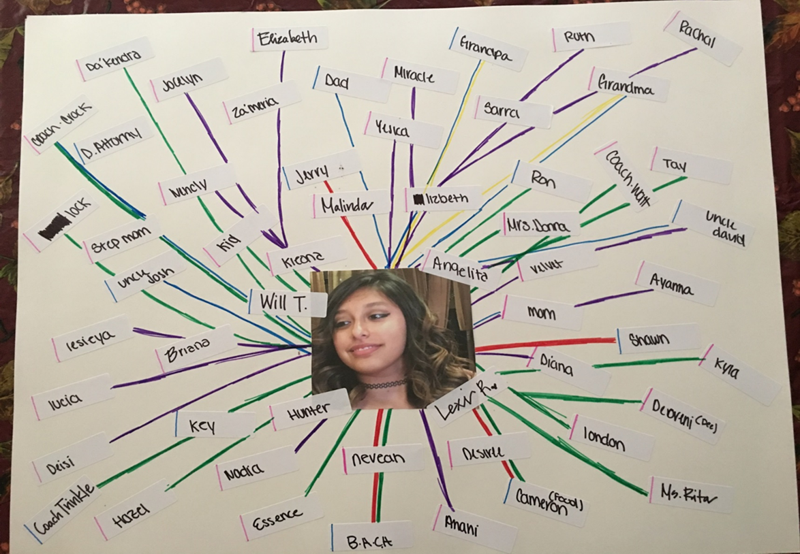
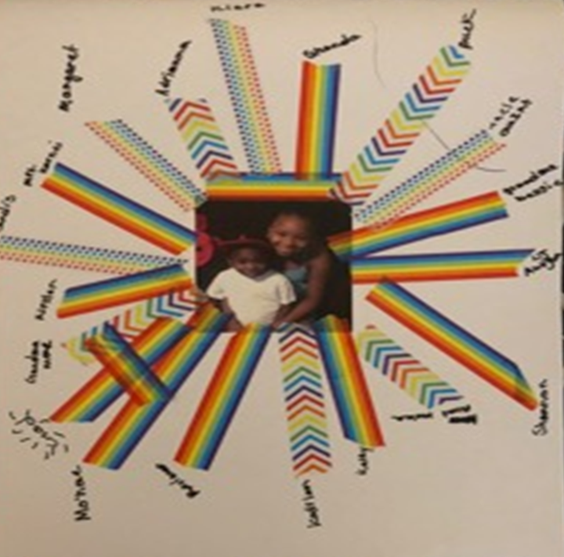
Connectedness Map

Slide 16



Circles of Trust: Demonstration & Practice
You + me + a piece of paper + a writing utensil = ​
Circles of Trust practice​

Slide 17
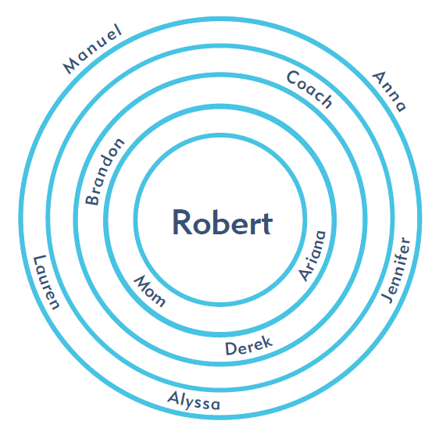
Circles of Trust

Slide 18
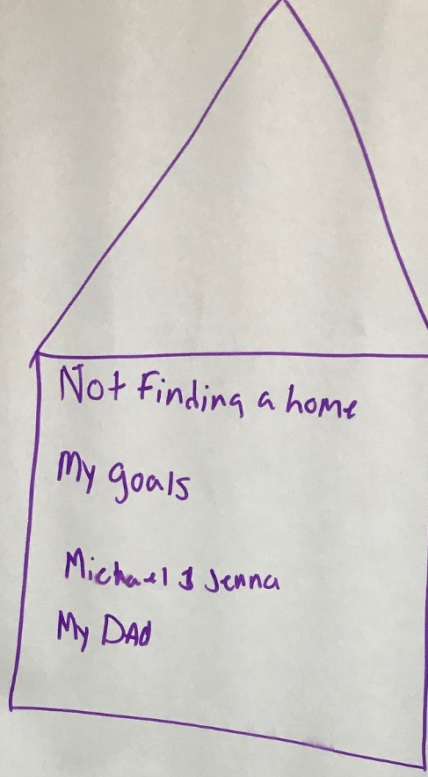
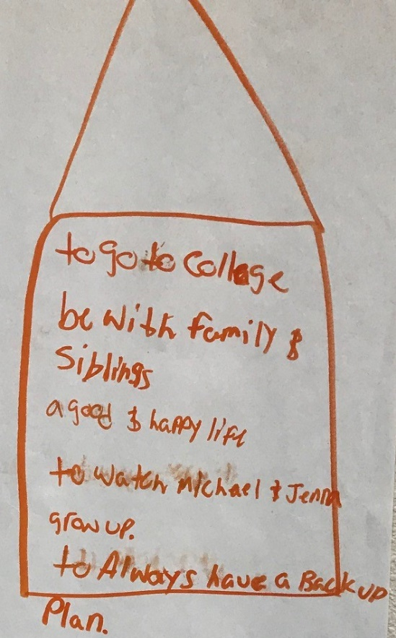
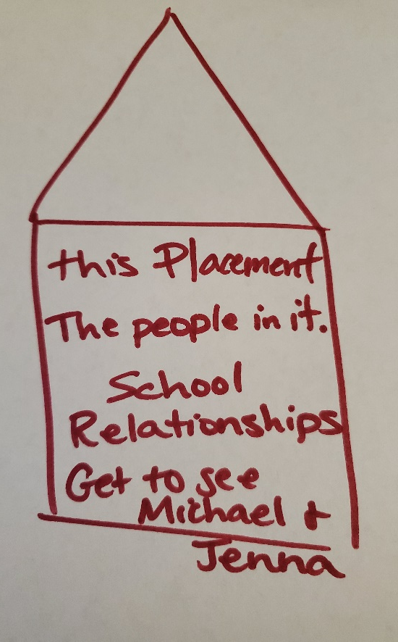
Three Houses
House of Worries
House of Good Things
House of Dreams

Slide 19
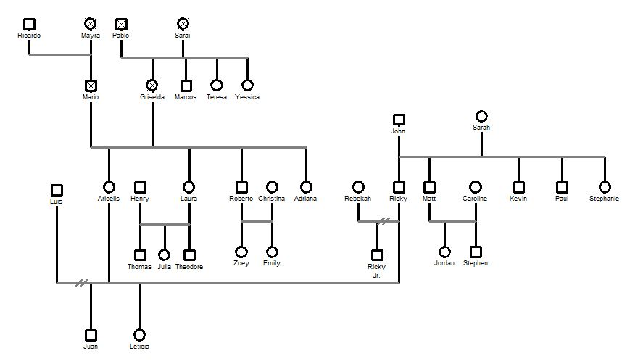
Genogram/Family Tree

Slide 20
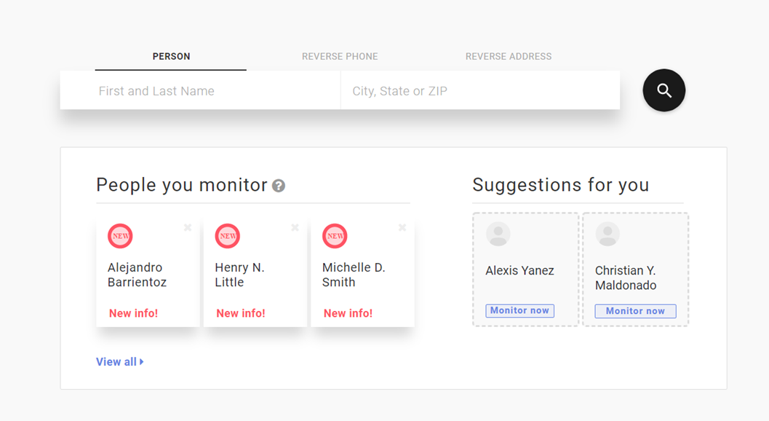
White Pages
Home Address
Phone Numbers
Related People
Address & Property History

Slide 21
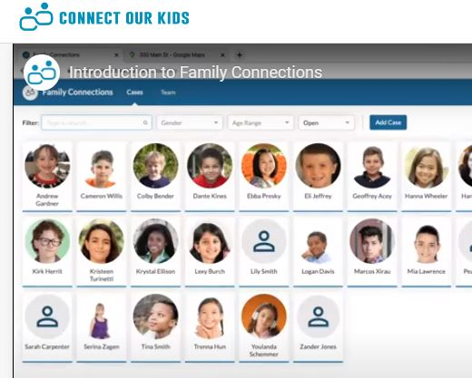
Connect Our Kids & People Search
Family Trees
Searching – phone number, email, social media profiles, physical address, possible family members, provides scripts and templates

Slide 22
Let’s Remember the Why of ECFE
Goals:
Connections of the child identified and engaged by the Adversary hearing
Building a relationship with parents and family will ensure a stronger collaboration
Earlier engagement with all involved
CASA advocacy sooner

Slide 23

Follow Up
Questions?
Thank You!
(Insert CFE Coach, CFE lead, Program Director contact info)

